Slide 1

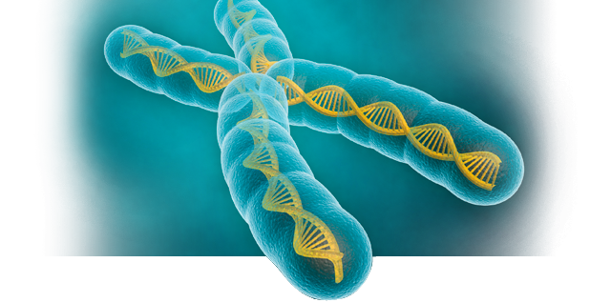
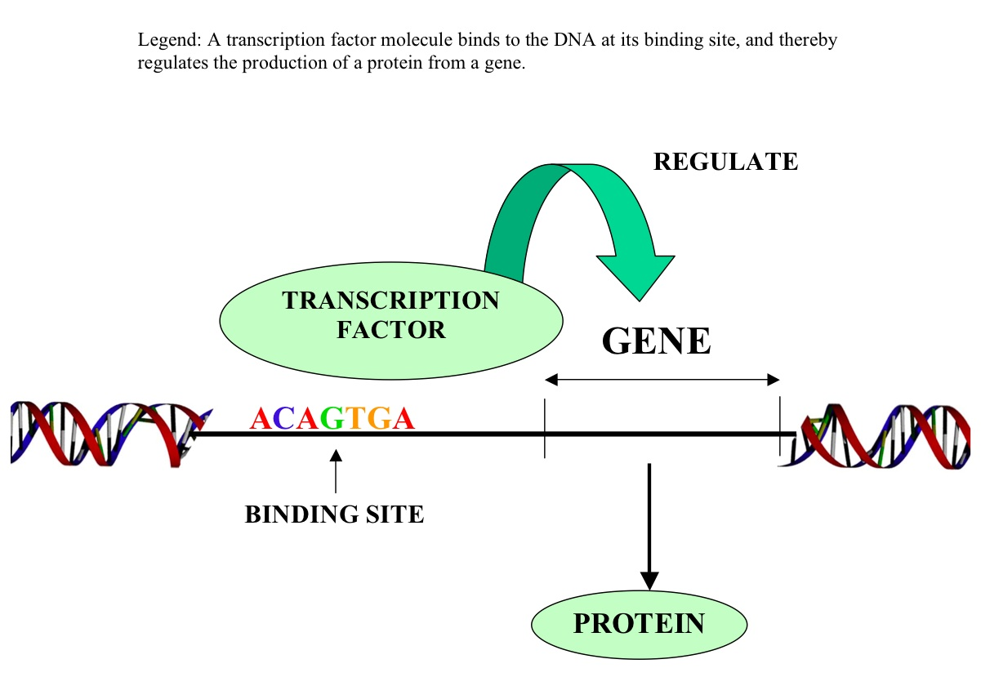
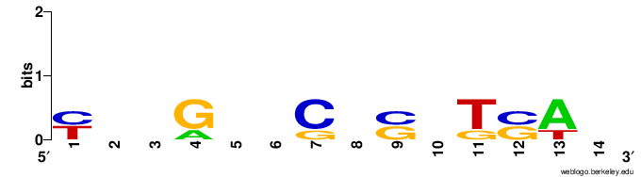
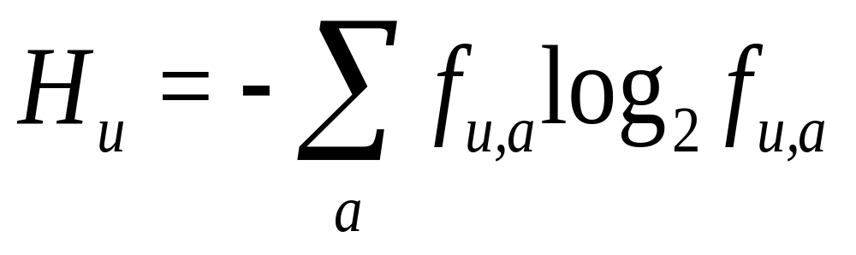
Motif Finding:
Finding binding sites for transcription factors using randomized algorithms
An IRC by Andrew Buxa
Abstract: In the field of biology, genes which are able to be turned on and off at the same time are co-regulated. This can be attributed to a common pattern found upstream from a gene which are called motifs. There are many ways of finding motifs, however, one of the most common method of finding motifs are randomized algorithms. We use these randomized algorithms because they produce good results in a reasonable amount of time. My research compares three of these randomized search algorithms for accuracy and efficiency. These algorithms are Gibbs Sampling, Randomized Motif Search and the MEME algorithm.
A motif is another word for the binding site which a transcription factor binds to in order to regulate the gene (turns it on or off) to create a protein that is does a select task.
Implementation and Analysis:
Given these sequences:
TCCGGTCGCATCTC
CGTAATCTCCGCAT
TGCGAGCGGGTGAG
CAAGTCGCGTTGAT
A profile matrix must be made to indicate what the probability of a certain nucleotide at each position would be. In the table above, you can see there’s an equal probability of a C and T being in the first position of the aligned sequences (highlighted in red)
We can calculate a logo based off the common nucleotides in each position of the sequences. Example, position one: T’s and C’s are equal thus C and T are equal size in the logo.
Column (in red)
 | 1
A | 0
C | 2/4
G | 0
T | 2/4
We can find a score for these possible “motifs” by calculating its Entropy where f is the profile matrix:
From the sequences given above, using each of the algorithms coded up, we can see the selected best motifs. The lowest score is always the best.
Entropy for the sequences above: 0.16755428569068753
We can compare both Randomized Search and Gibbs sampling by looking at the similarities of the motifs found as well as the run time.
Randomized Search:
Output: ['CGC', 'CGC', 'CGG', 'CGC']
Time: 0.09106206893920898 seconds
Gibbs Sampling:
Output: ['CGC', 'CGT', 'GAG', 'AAG']
Time: 3.126127004623413 seconds
MEME:
Will be completed before presentation
As we can see, Randomized search has found very similar motifs in a less amount of time because gibbs sampling had to iterate over the sequences 500 times (takes in an amount of iterations to increase odds of finding a perfect motif)
Related Work
To everyone else who programmed these algorithms, I would think our results are the same. But there could be additions to the algorithms to find multiple motifs rather than one select group in a set of sequences.
There are some differences between Gibbs Sampling and Randomized Search. Randomized Search uses a different scoring method than Gibbs Sampling.
References:
https://www.luminexcorp.com/research/our-technology/methods/gene-expression/
http://weblogo.berkeley.edu/logo.cgi
Compeau, Phillip, and Pavel Pevzner. Bioinformatics Algorithms: An Active Learning Approach. La Jolla, CA: Active Learning, 2015. Print.

